Slide 1
Creational Design Patterns
Instructor: Mehroze Khan

Slide 2
Creational Design Patterns
Creational design patterns provide various object creation mechanisms, which increase flexibility and reuse of existing code.
Creational design patterns abstract the instantiation process.
They help make a system independent of how its objects are created, composed, and represented.
A class creational pattern uses inheritance to vary the class that's instantiated.
An object creational pattern will delegate instantiation to another object.

Slide 3
Creational Design Patterns
First, they all encapsulate knowledge about which concrete classes the system uses.
Second, they hide how instances of these classes are created and put together.
Creational patterns give you a lot of flexibility in what gets created, who creates it, how it gets created, and when.

Slide 4
Factory Method Pattern

Slide 5
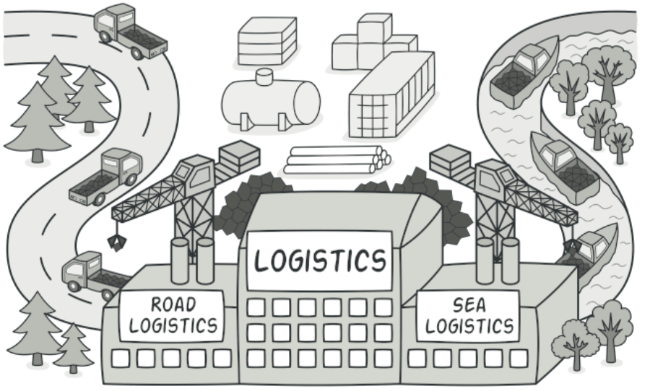
Factory Method
Intent:
Factory Method is a creational design pattern that provides an interface for creating objects in a superclass but allows subclasses to alter the type of objects that will be created.
It is also known as Virtual Constructor

Slide 6
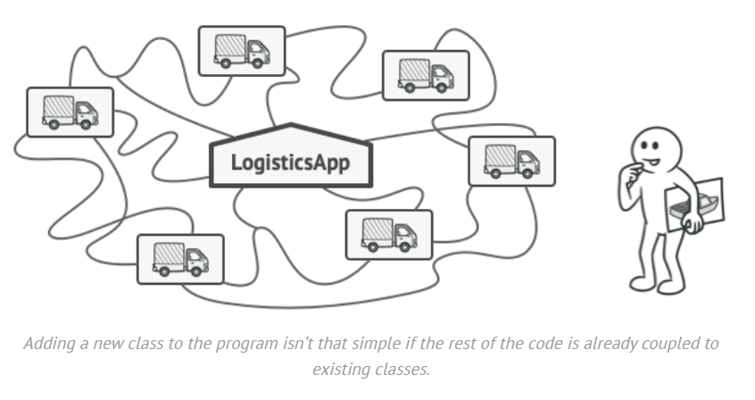
Problem
Imagine that you’re creating a logistics management application. The first version of your app can only handle transportation by trucks, so the bulk of your code lives inside the Truck class.
After a while, your app becomes popular. Each day you receive dozens of requests from sea transportation companies to incorporate sea logistics into the app.

Slide 7
Problem
At present, most of your code is coupled to the Truck class. Adding Ships into the app would require making changes to the entire codebase.
Moreover, if later you decide to add another type of transportation to the app, you will probably need to make all these changes again.
As a result, you will end up with nasty code, riddled with conditionals that switch the app’s behavior depending on the class of transportation objects.

Slide 8
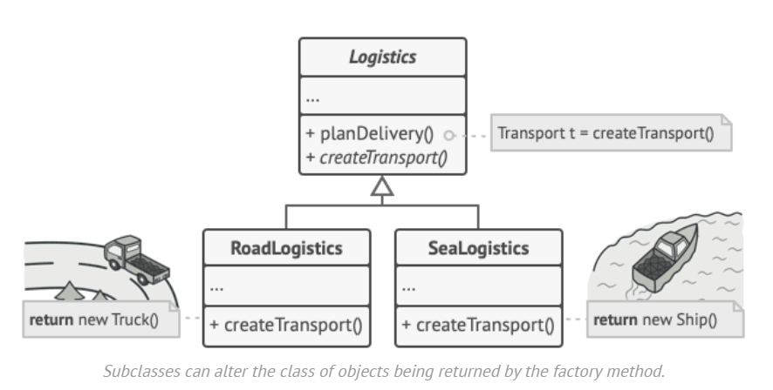
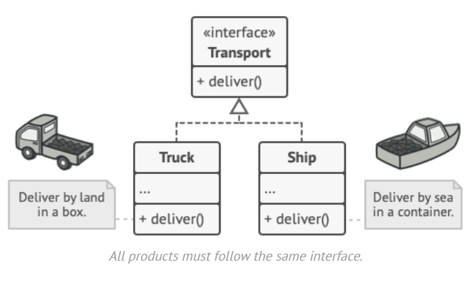
Solution
The Factory Method pattern suggests that you replace direct object construction calls (using the new operator) with calls to a special factory method.
Objects are still created via the new operator, but it’s being called from within the factory method.
Objects returned by a factory method are often referred to as products.

Slide 9
Solution
At first glance, this change may look pointless: we just moved the constructor call from one part of the program to another.
However, consider this: now you can override the factory method in a subclass and change the class of products being created by the method.
There’s a slight limitation though: subclasses may return different types of products only if these products have a common base class or interface.
Also, the factory method in the base class should have its return type declared as this interface.

Slide 10
Solution
For example, both Truck and Ship classes should implement the Transport interface, which declares a method called deliver.
Each class implements this method differently: trucks deliver cargo by land and ships deliver cargo by sea.
The factory method in the RoadLogistics class returns truck objects, whereas the factory method in the SeaLogistics class returns ships.
Product
Creator
Concrete Product
Concrete Creator

Slide 11
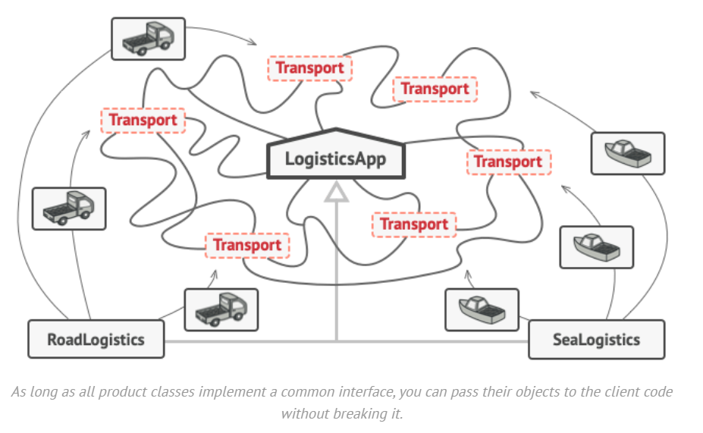
Solution
The code that uses the factory method (often called the client code) doesn’t see a difference between the actual products returned by various subclasses.
The client treats all the products as abstract Transport.
The client knows that all transport objects are supposed to have the deliver method, but exactly how it works isn’t important to the client.

Slide 12
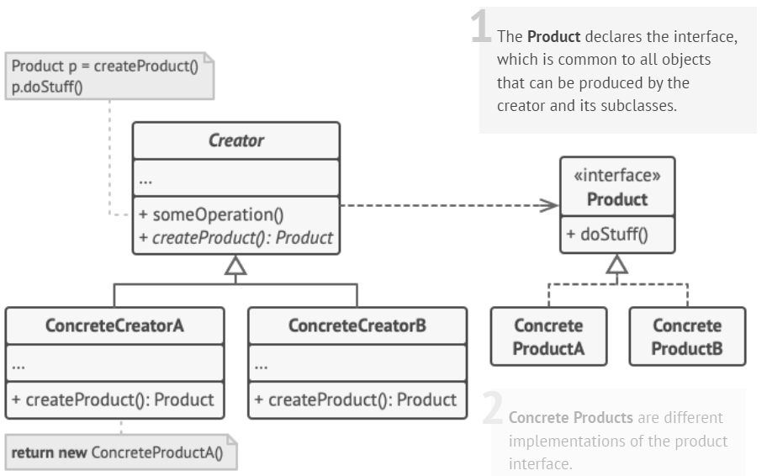
Structure

Slide 13
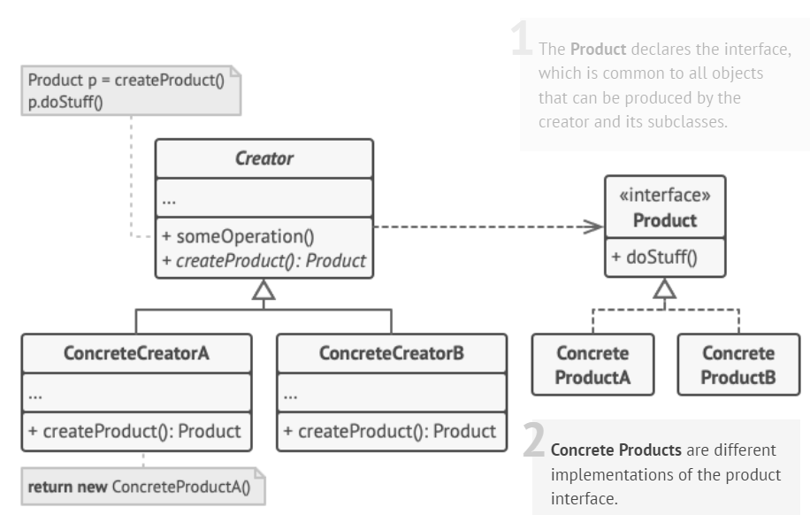
Structure

Slide 14
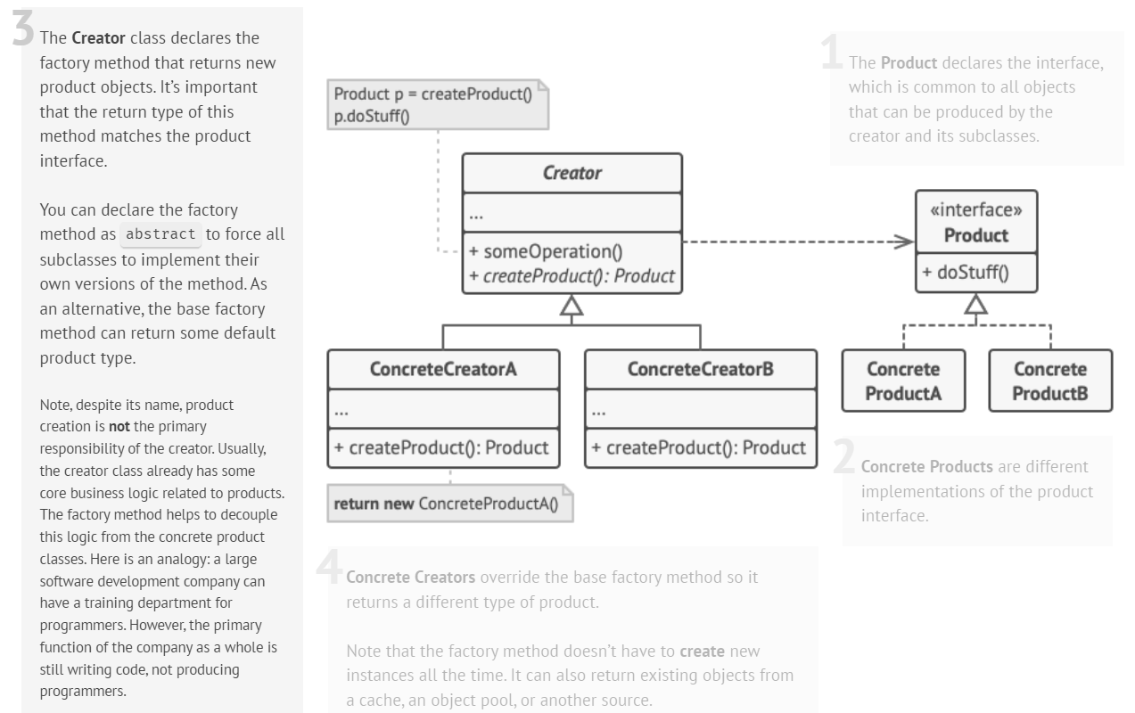

Slide 15
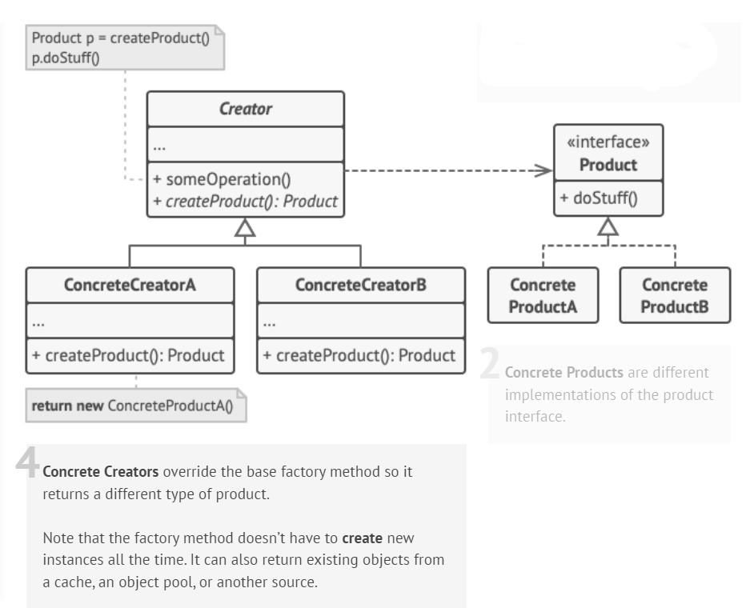
Structure

Slide 16
Example
// Library classes
class Vehicle {
public:
virtual void printVehicle() = 0;
};
class TwoWheeler : public Vehicle {
public:
void printVehicle()
{
cout << "I am two wheeler" << endl;
}
};
class FourWheeler : public Vehicle {
public:
void printVehicle()
{
cout << "I am four wheeler" << endl;
} };
// Client (or user) class
class Client {
public:
Client(int type)
{
// Client explicitly creates classes according to type
if (type == 1)
pVehicle = new TwoWheeler();
else if (type == 2)
pVehicle = new FourWheeler();
else
pVehicle = NULL;
}
Vehicle* getVehicle() { return pVehicle; }
private:
Vehicle* pVehicle;
};

Slide 17
Example
// Driver program
int main()
{
Client* pClient = new Client(1);
Vehicle* pVehicle = pClient->getVehicle();
pVehicle->printVehicle();
return 0;
}
//Output: I am two wheeler

Slide 18
Problem with this design?
What are the problems with the above design?
As you must have observed in the above example, the Client creates objects of either TwoWheeler or FourWheeler based on some input during the construction of its object.
Say, the library introduces a new class ThreeWheeler to incorporate three-wheeler vehicles also.
What would happen?
The client will end up chaining a new else if in the conditional ladder to create objects of ThreeWheeler. Which in turn will need the Client to be recompiled.
So, each time a new change is made on the library side, the Client would need to make some corresponding changes at its end and recompile the code.
Sounds bad? This is a very bad practice of design.
How do we avoid the problem?
The answer is, to create a vehicle’s factory class with a single responsibility to create the objects.

Slide 19
Example
enum VehicleType {
VT_TwoWheeler,
VT_ThreeWheeler,
VT_FourWheeler
};
// Library classes
class Vehicle {
public:
virtual void printVehicleInfo() = 0;
};
class TwoWheeler : public Vehicle {
public:
void printVehicleInfo()
{
cout << "I am two wheeler" << endl;
}
};
class ThreeWheeler : public Vehicle {
public:
void printVehicleInfo()
{
cout << "I am three wheeler" << endl;
}
};
class FourWheeler : public Vehicle {
public:
void printVehicleInfo()
{
cout << "I am four wheeler" << endl;
}
};

Slide 20
Example
// Class Vehicle Factory with a single responsibility to construct Vehicles according to the clients' requests.
class VehicleFactory {
public:
Vehicle* build(VehicleType vehicleType)
{
if (vehicleType == VT_TwoWheeler)
return new TwoWheeler();
else if (vehicleType == VT_ThreeWheeler)
return new ThreeWheeler();
else if (vehicleType == VT_FourWheeler)
return new FourWheeler();
else
return nullptr;
}
};
// Client class. The client object will ask the factory to build vehicles.
class Client {
public:
Client() {
pVehicle = nullptr;
}
void BuildVehicle(VehicleType vehicleType)
{
VehicleFactory* vf = new VehicleFactory();
pVehicle = vf->build(vehicleType);
}
Vehicle* getVehicle() { return pVehicle; }
private:
Vehicle* pVehicle;
};

Slide 21
Example
// Driver program
int main()
{
Client* pClient = new Client();
pClient->BuildVehicle(VT_TwoWheeler);
pClient->getVehicle()->printVehicleInfo();
pClient->BuildVehicle(VT_ThreeWheeler);
pClient->getVehicle()->printVehicleInfo();
pClient->BuildVehicle(VT_FourWheeler);
pClient->getVehicle()->printVehicleInfo();
}
//Output
I am two wheeler
I am three wheeler
I am four wheeler

Slide 22
Example
In the above example, we have totally decoupled the selection of types for object creation from the Client.
The factory class is now responsible for deciding which object type to create based on the input provided by the client.
The client just needs to make calls to the factory class's build method and pass the type it wants without worrying about the actual implementation of the creation of objects.

Slide 23
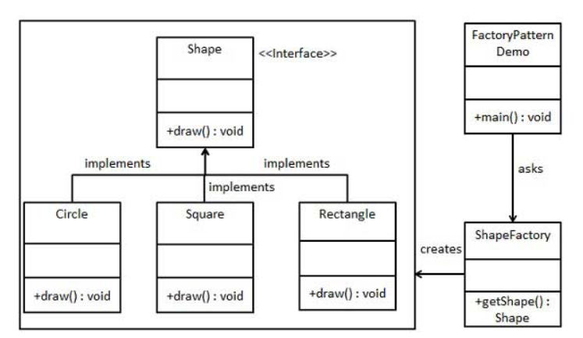
Another Example

Slide 24
Example
// Step 1: Create interface
public interface Shape {
void draw();
}
// Step 2: Create concrete classes implementing the interface
public class Rectangle implements Shape {
@Override
public void draw() {
System.out.println("Inside Rectangle::draw() method.");
}
}
public class Square implements Shape {
@Override
public void draw() {
System.out.println("Inside Square::draw() method.");
}
}
public class Circle implements Shape {
@Override
public void draw() {
System.out.println("Inside Circle::draw() method.");
}
}

Slide 25
Example
// Step 3: Create a Factory to generate object of concrete class based on given information.
public class ShapeFactory {
//use getShape method to get object of type shape
public Shape getShape(String shapeType){
if(shapeType == null){
return null;
}
if(shapeType.equalsIgnoreCase("CIRCLE")){
return new Circle();
} else if(shapeType.equalsIgnoreCase("RECTANGLE")){
return new Rectangle();
} else if(shapeType.equalsIgnoreCase("SQUARE")){
return new Square();
}
return null;
}
}
// Step 4: Use the Factory to get object of concrete class by passing an information such as type.
public class FactoryPatternDemo {
public static void main(String[] args) {
ShapeFactory shapeFactory = new ShapeFactory();
//get an object of Circle and call its draw method.
Shape shape1 = shapeFactory.getShape("CIRCLE");
//call draw method of Circle
shape1.draw();
//get an object of Rectangle and call its draw method.
Shape shape2 = shapeFactory.getShape("RECTANGLE");
//call draw method of Rectangle
shape2.draw();
//get an object of Square and call its draw method.
Shape shape3 = shapeFactory.getShape("SQUARE");
//call draw method of square
shape3.draw();
} }

Slide 26
Example
// Step 4: Use the Factory to get object of concrete class by passing an information such as type.
public class FactoryPatternDemo {
public static void main(String[] args) {
ShapeFactory shapeFactory = new ShapeFactory();
//get an object of Circle and call its draw method.
Shape shape1 = shapeFactory.getShape("CIRCLE");
//call draw method of Circle
shape1.draw();
//get an object of Rectangle and call its draw method.
Shape shape2 = shapeFactory.getShape("RECTANGLE");
//call draw method of Rectangle
shape2.draw();
//get an object of Square and call its draw method.
Shape shape3 = shapeFactory.getShape("SQUARE");
//call draw method of square
shape3.draw();
} }
// Output:
Inside Circle::draw() method.
Inside Rectangle::draw() method.
Inside Square::draw() method.

Slide 27
Singleton Pattern

Slide 28
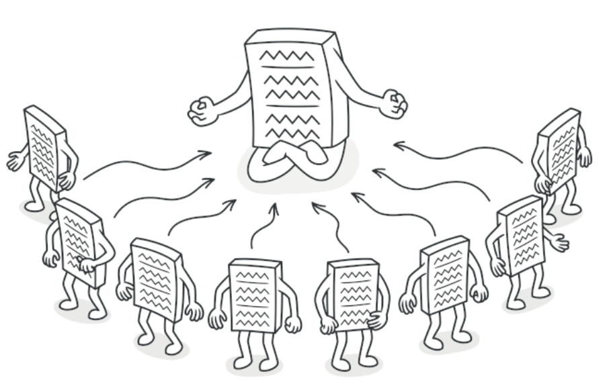
Singleton Pattern
Intent
Singleton is a creational design pattern that lets you ensure that a class has only one instance, while providing a global access point to this instance.

Slide 29
Problem
The Singleton pattern solves two problems at the same time, violating the Single Responsibility Principle:
Ensure that a class has just a single instance.
Why would anyone want to control how many instances a class has?
The most common reason for this is to control access to some shared resource—for example, a database or a file.
Imagine that you created an object, but after a while decided to create a new one. Instead of receiving a fresh object, you’ll get the one you already created.
This behavior is impossible to implement with a regular constructor since a constructor call must always return a new object by design.

Slide 30
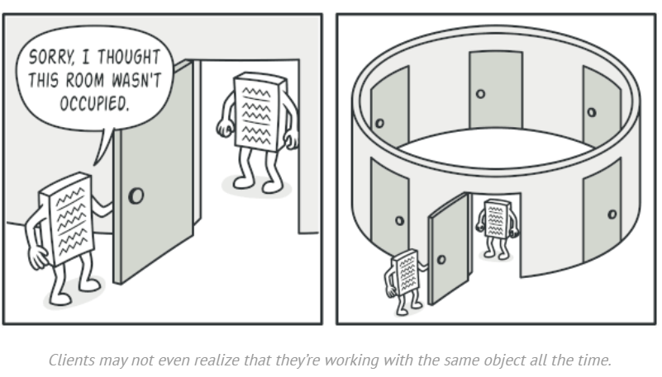

Slide 31
Problem
Provide a global access point to that instance.
Just like a global variable, the Singleton pattern lets you access some object from anywhere in the program.
However, it also protects that instance from being overwritten by other code.
There’s another side to this problem:
You don’t want the code that solves problem #1 to be scattered all over your program. It’s much better to have it within one class, especially if the rest of your code already depends on it.

Slide 32
Solution
All implementations of the Singleton have these two steps in common:
Make the default constructor private, to prevent other objects from using the new operator with the Singleton class.
Create a static creation method that acts as a constructor. Under the hood, this method calls the private constructor to create an object and saves it in a static field. All following calls to this method return the cached object.
If your code has access to the Singleton class, then it’s able to call the Singleton’s static method. So, whenever that method is called, the same object is always returned.

Slide 33
Real World Analogy
The government is an excellent example of the Singleton pattern.
A country can have only one official government.
Regardless of the personal identities of the individuals who form governments, the title, “The Government of X”, is a global point of access that identifies the group of people in charge.

Slide 34
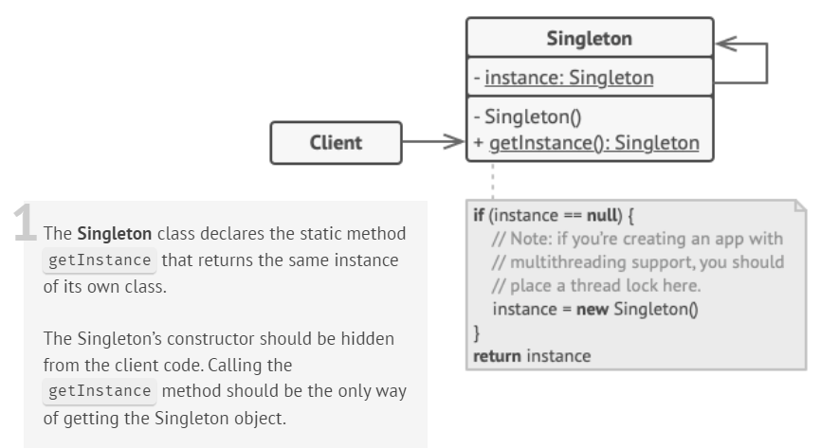
Strcuture

Slide 35
Implementation (Lazy Initialization)
class Singleton {
private:
static Singleton *instance;
int data;
// Private constructor so that no objects can be created.
Singleton() {
data = 0;
}
public:
// Lazy Initialization
static Singleton *getInstance() {
if (instance == NULL) {
instance = new Singleton();
}
return instance;
}
int getData() {
return this -> data;
}
void setData(int data) {
this -> data = data;
}
};

Slide 36
Implementation
//Initialize pointer with NULL so that it can be initialized in first call to getInstance()
Singleton *Singleton::instance = NULL;
int main(){
Singleton *s = Singleton::getInstance();
s->setData(7);
cout << s->getData() << endl;
Singleton *p = Singleton::getInstance();
p->setData(100);
cout << p->getData() << endl;
return 0;
}
Output:
// 7
// Address of s : 0x1793010
// 100
// Address of p : 0x1793010

Slide 37
Implementation (Eager Initialization)
class Singleton {
private:
static Singleton *instance = new Singleton();
int data;
// Private constructor so that no objects can be created.
Singleton() {
data = 0;
}
public:
// Eager Initialization
static Singleton *getInstance() {
return instance;
}
int getData() {
return this -> data;
}
void setData(int data) {
this -> data = data;
}
};

Slide 38
Implementation (Lazy Initialization in Multi-Thread)
class Singleton {
private:
static Singleton *instance;
int data;
static mutex mtx; // Lock for synchronization
// Private constructor so that no objects can be created.
Singleton() {
data = 0;
}
public:
int getData() {
return this->data;
}
void setData(int data) {
this->data = data;
}
// Lazy Initialization with synchronization
static Singleton *getInstance() {
if (instance == nullptr) {
lock_guard<mutex> lock(mtx); // Locking
if (instance == nullptr) {
instance = new Singleton();
}
}
return instance;
}
};

Slide 39
Implementation (Lazy Initialization in Multi-Thread)
// Initializing static members
Singleton* Singleton::instance = nullptr;
mutex Singleton::mtx;
int main() {
Singleton* s1 = Singleton::getInstance();
s1->setData(42);
Singleton* s2 = Singleton::getInstance();
cout << s2->getData() << endl;
return 0;
}
// Output: 42

Slide 40
References
Design Patterns: Elements of Reusable Object-Oriented Software, Erich Gamma, Richard Helm, Ralph Johnson, and John Vlissides, Pearson, 1995.
Helping Links:
https://refactoring.guru/design-patterns/
https://www.geeksforgeeks.org/factory-method-for-designing-pattern/
https://sourcemaking.com/design_patterns/

